Slide 1

Generative AI Prompt Engineering for
Geospatial Python Development
Brian Tomaszewski, Ph.D.
Professor Rochester Institute of Technology, USA
bmtski@rit.edu

Slide 2
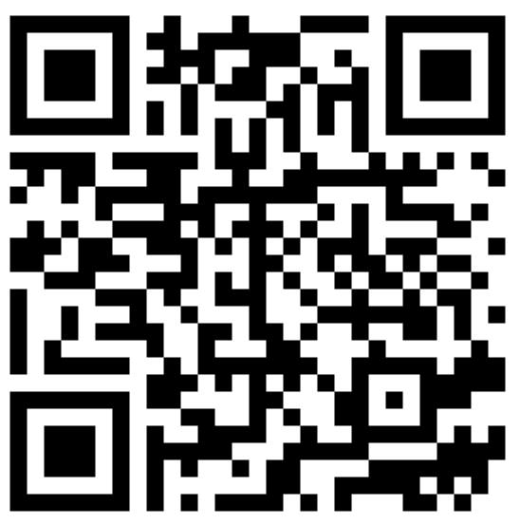
Workshop Materials
https://gisfordisastermanagement.com/youtube/

Slide 3
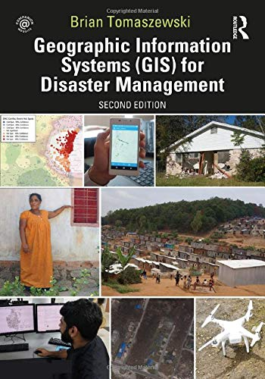
Who am I?
Ph.D. – Geography – Penn State
Professor – Rochester Institute of Technology (RIT), USA
Lab - Center for Geographic Information Science and Technology
Research – Spatial Data Science, Humanitarian

Slide 4
Workshop Objectives
Identify opportunities for using generative AI for geospatial python code development.
Demonstrate how to create effective prompts to generate geospatial python code.
Recognize limitations of generative AI for python code development and how to troubleshoot erroneous code.
Identify opportunities for advanced application of generative AI for geospatial python development using modern developer tools.

Slide 5
Before we start:
ArcGIS Pro
VS Code
ChatGPT 4o
Assume some Python background
Disclaimer: Not a full time developer, many ways to accomplish tasks

Slide 6


FYI – RIT Certified: Spatial Data Science
https://certified.rit.edu/

Slide 7
Outline
Generative AI Overview
Generative AI and Geospsatial
Prompt Engineering
Hands On with Prompt Engineering

Slide 8

What is Generative AI?
Content Production
Notes:
Create an image that summarizes all the things that generative AI can do like creating text images code and other things maybe I'm not thinking about do not add any actual text though I just want graphical representations of what generative AI can do

Slide 9
Large Language Models
Large language model: computer program that has learned from a huge amount of text to predict and generate human-like language
Neural Networks : Neural networks are pattern-finding machines that learn from examples
https://en.wikipedia.org/wiki/Large_language_model

Slide 10
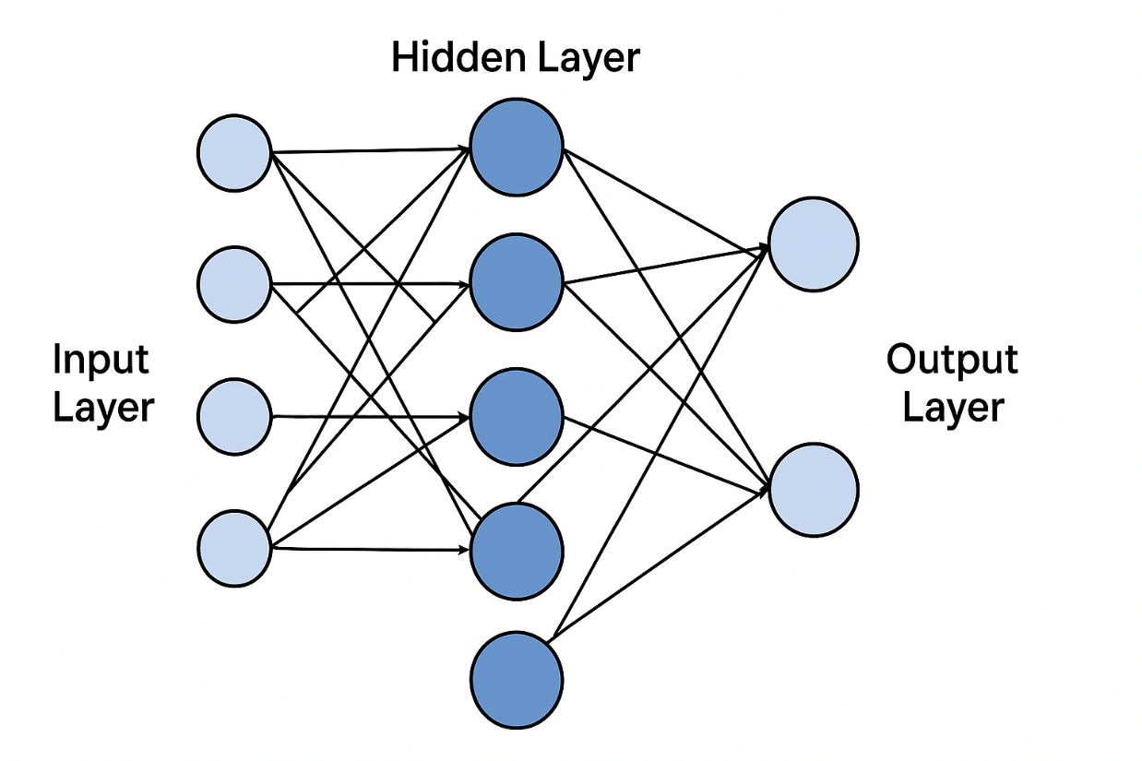
Neural Networks
Give the network some input, like words or pixels.
Information passes through many layers of tiny decision-makers called neurons.
Each neuron looks at the input, makes a small "vote," and passes it on.
The network produces an output, like the next word, a caption, or a full reply.
Notes:
A real-world analogy: Think about how people learn to recognize a dog:
A baby sees lots of animals.
Every time someone points and says "dog," the baby’s brain adjusts a little.
Over time, it gets really good at spotting dogs, even different breeds.
A neural network does something similar — but with math instead of neurons in a brain.
Hidden layers are where a neural network processes and transforms information before making a final prediction. (like immesiate data in a model?)

Slide 11
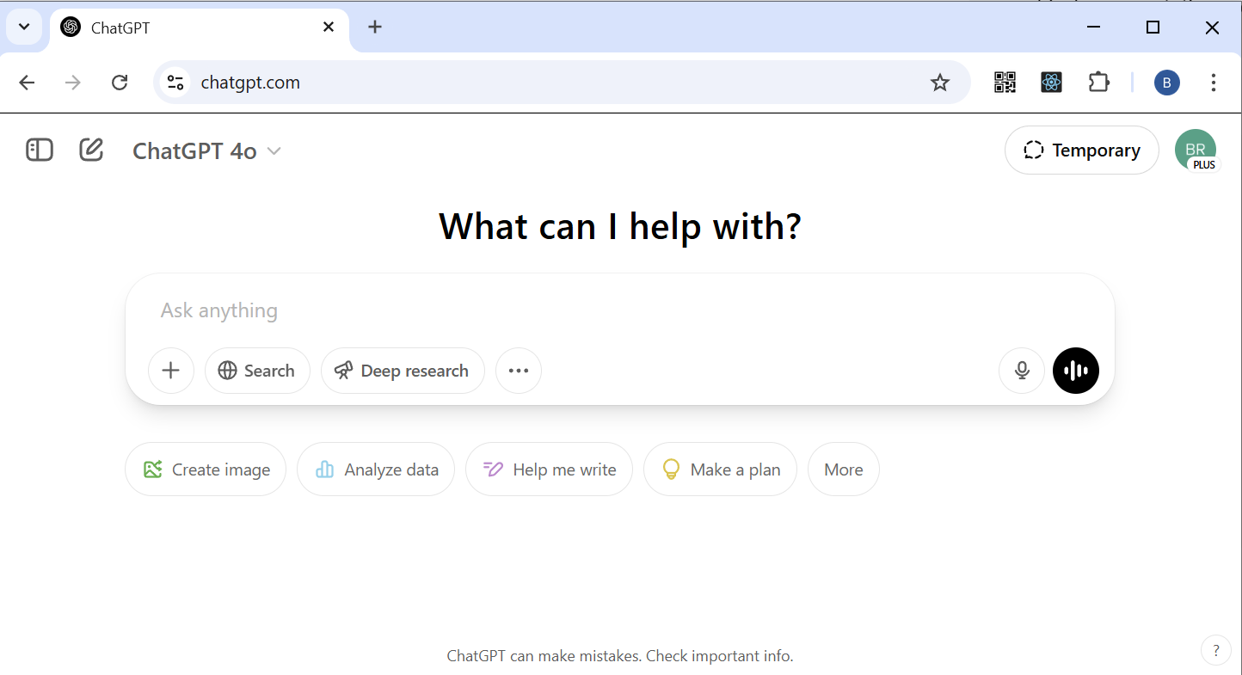
ChatGPT
https://chatgpt.com/

Slide 12
ChatGPT and Geospatial
ChatGPT knows geospatial!
Software task support
Like Google searching but more natural, AI teacher
Code generation – today’s focus

Slide 13
How many geospatial APIs are you familiar with?
Esri ArcGIS APIs
OGC Standards APIs (WMS, WFS, WCS)
Google Maps and Google Earth Engine APIs
Mapbox APIs
Leaflet
PostGIS
CesiumJS
OpenLayers
Deck.gl
Turf.js
Geopandas and Shapely
pyproj
GDAL/OGR
HERE Maps APIs
TomTom Maps APIs
Carto APIs
Notes:
How many geospatial APIs are you familiar with?

Slide 14
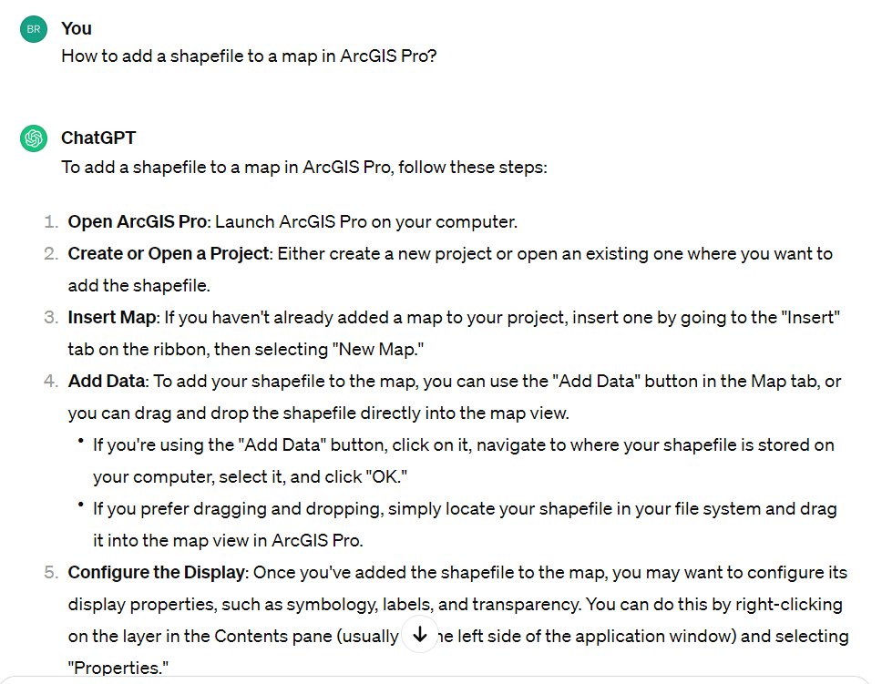
Software task support
Notes:
How do I add a shape file in arcgis pro?

Slide 15
Key Geospatial Generative AI skills
Prompt engineering –very precise
Need to know what to ask it – importance of understanding GIS concepts
Need to know how to handle code
ChatGPT can outcode you – you may receive code back that works but do you not understand how it is working – ask for comments
ChatGPT can be outdated with software- ask about version!

Slide 16

Prompt Engineering
The practice of designing and refining input questions or instructions to guide the AI toward producing more accurate, useful, or creative responses.

Slide 17
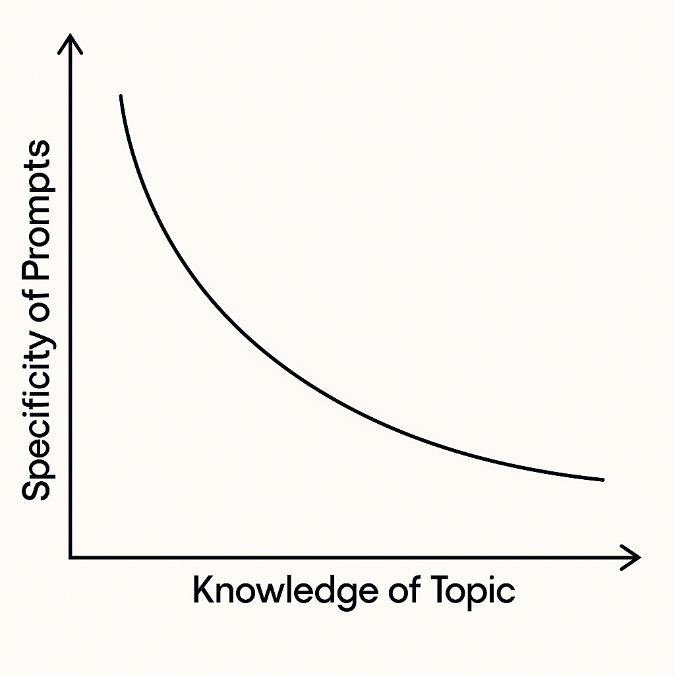
Broad
Narrow
Less
More
Notes:
the less knowledge you have, the more broad your prompt is the more knowledge you have the more specific you're prompt can be

Slide 18
Prompt Engineering - Framework
1. Provide Necessary Context: Briefly set the scene so the task is clearly grounded.
2. Describe the Task: Clearly state what ChatGPT should do.
3. Guide the Process: Explain the steps or methods ChatGPT should follow (and formatting if needed).
4. Define Expected Output: Specify the format, structure, and content of the final response.
5. Add Special Instructions (optional): Tone, length, style, etc.)
Zhang, H., Wu, C., Xie, J., Lyu, Y., Cai, J., & Carroll, J. M. (2023). Redefining qualitative analysis in the ai era: Utilizing chatgpt for efficient thematic analysis. arXiv preprint arXiv:2309.10771.
Notes:
1) Description of the Task’s Background. This part enables users to set the context and provide
information that helps ChatGPT to understand the nature and structure of the input data. 2)
Description of the Task. This part gives further instructions about the task that ChatGPT needs
to execute with the input data. 3) Description of how the task will be processed. This part serves
as a methodological guidance to ensure that ChatGPT will complete the task following a specific
procedure. 4) Description of the Expected Output Content

Slide 19
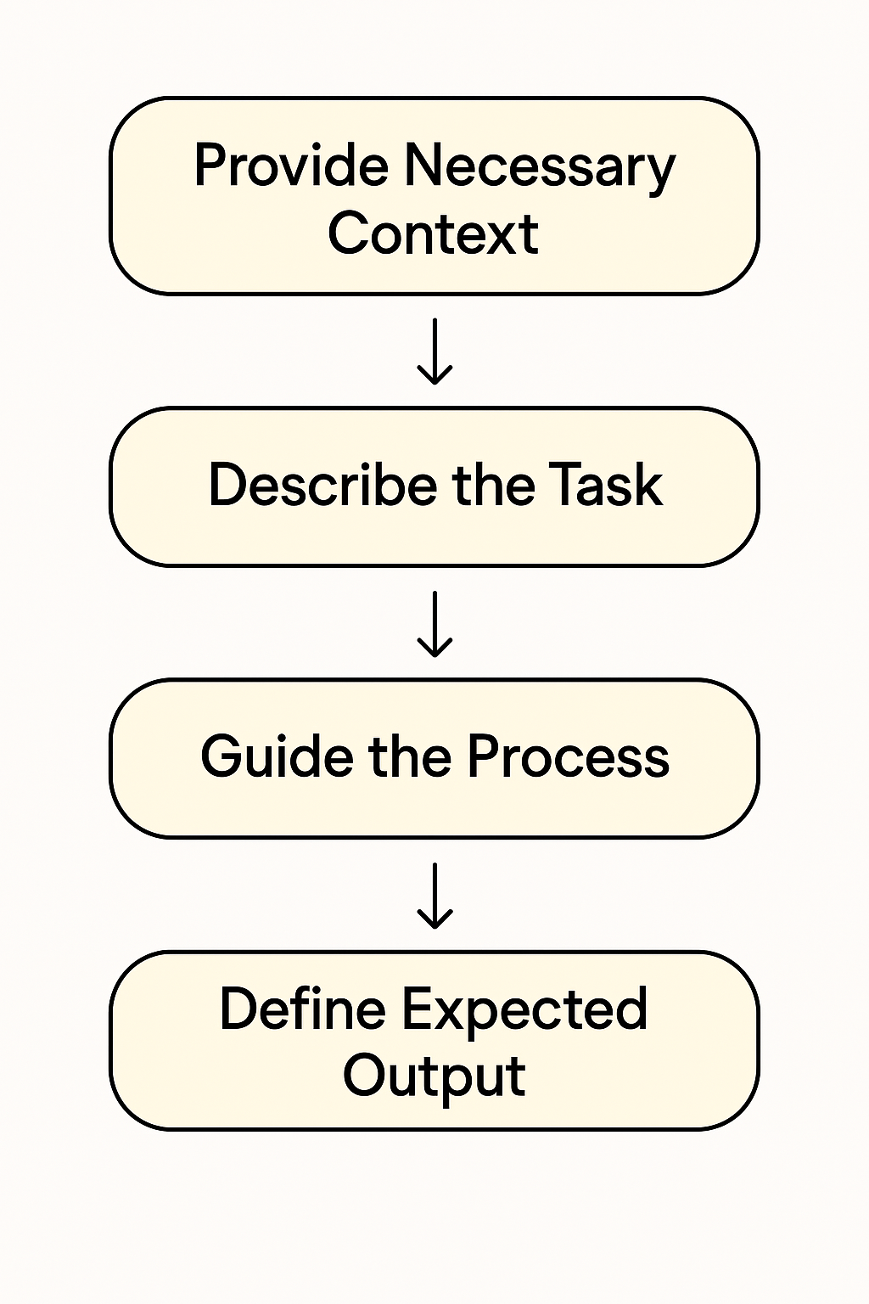
You are skilled data analyst who's is an expert knowledge in geographic information systems. With that in mind, I would like for you to generate for me a python script that will work with ArcGIS Pro ArcPy to accomplish the following tasks.
Select features from a layer in the map called ‘world_country_boundaries’ where values in the field ‘POP_RANK’ are greater than or equal to 15.
After you have made the selection, the features that were selected from ‘world_country_boundaries’ should then be exported as a new shapefile called ‘populated_world_countries’. You must save this new shapefile in the C:\ temp directory.
Provide extensive comments in all the code that you create and provide error handling for any problems might occur. Also provide basic feedback such as simple print statements as the process is running so the user knows what is happening.
prompt_basic_query_export.txt

Slide 20
Basic Process
Submit Prompt
Receive Code
Apply Code
Troubleshoot

Slide 21
Example – ArcGIS Pro – General Query
You are skilled data analyst who's is an expert knowledge in geographic information systems. With that in mind, I would like for you to generate for me a python script that will work with ArcGIS Pro ArcPy to accomplish the following tasks.
Select features from a layer in the map called ‘world_country_boundaries’ where values in the field ‘POP_RANK’ are greater than or equal to 15.
Provide extensive comments in all the code that you create and provide error handling for any problems might occur. Also provide basic feedback such as simple print statements as the process is running so the user knows what is happening.
prompt_basic_query.txt
https://pro.arcgis.com/en/pro-app/latest/arcpy/get-started/what-is-arcpy-.htm

Slide 22
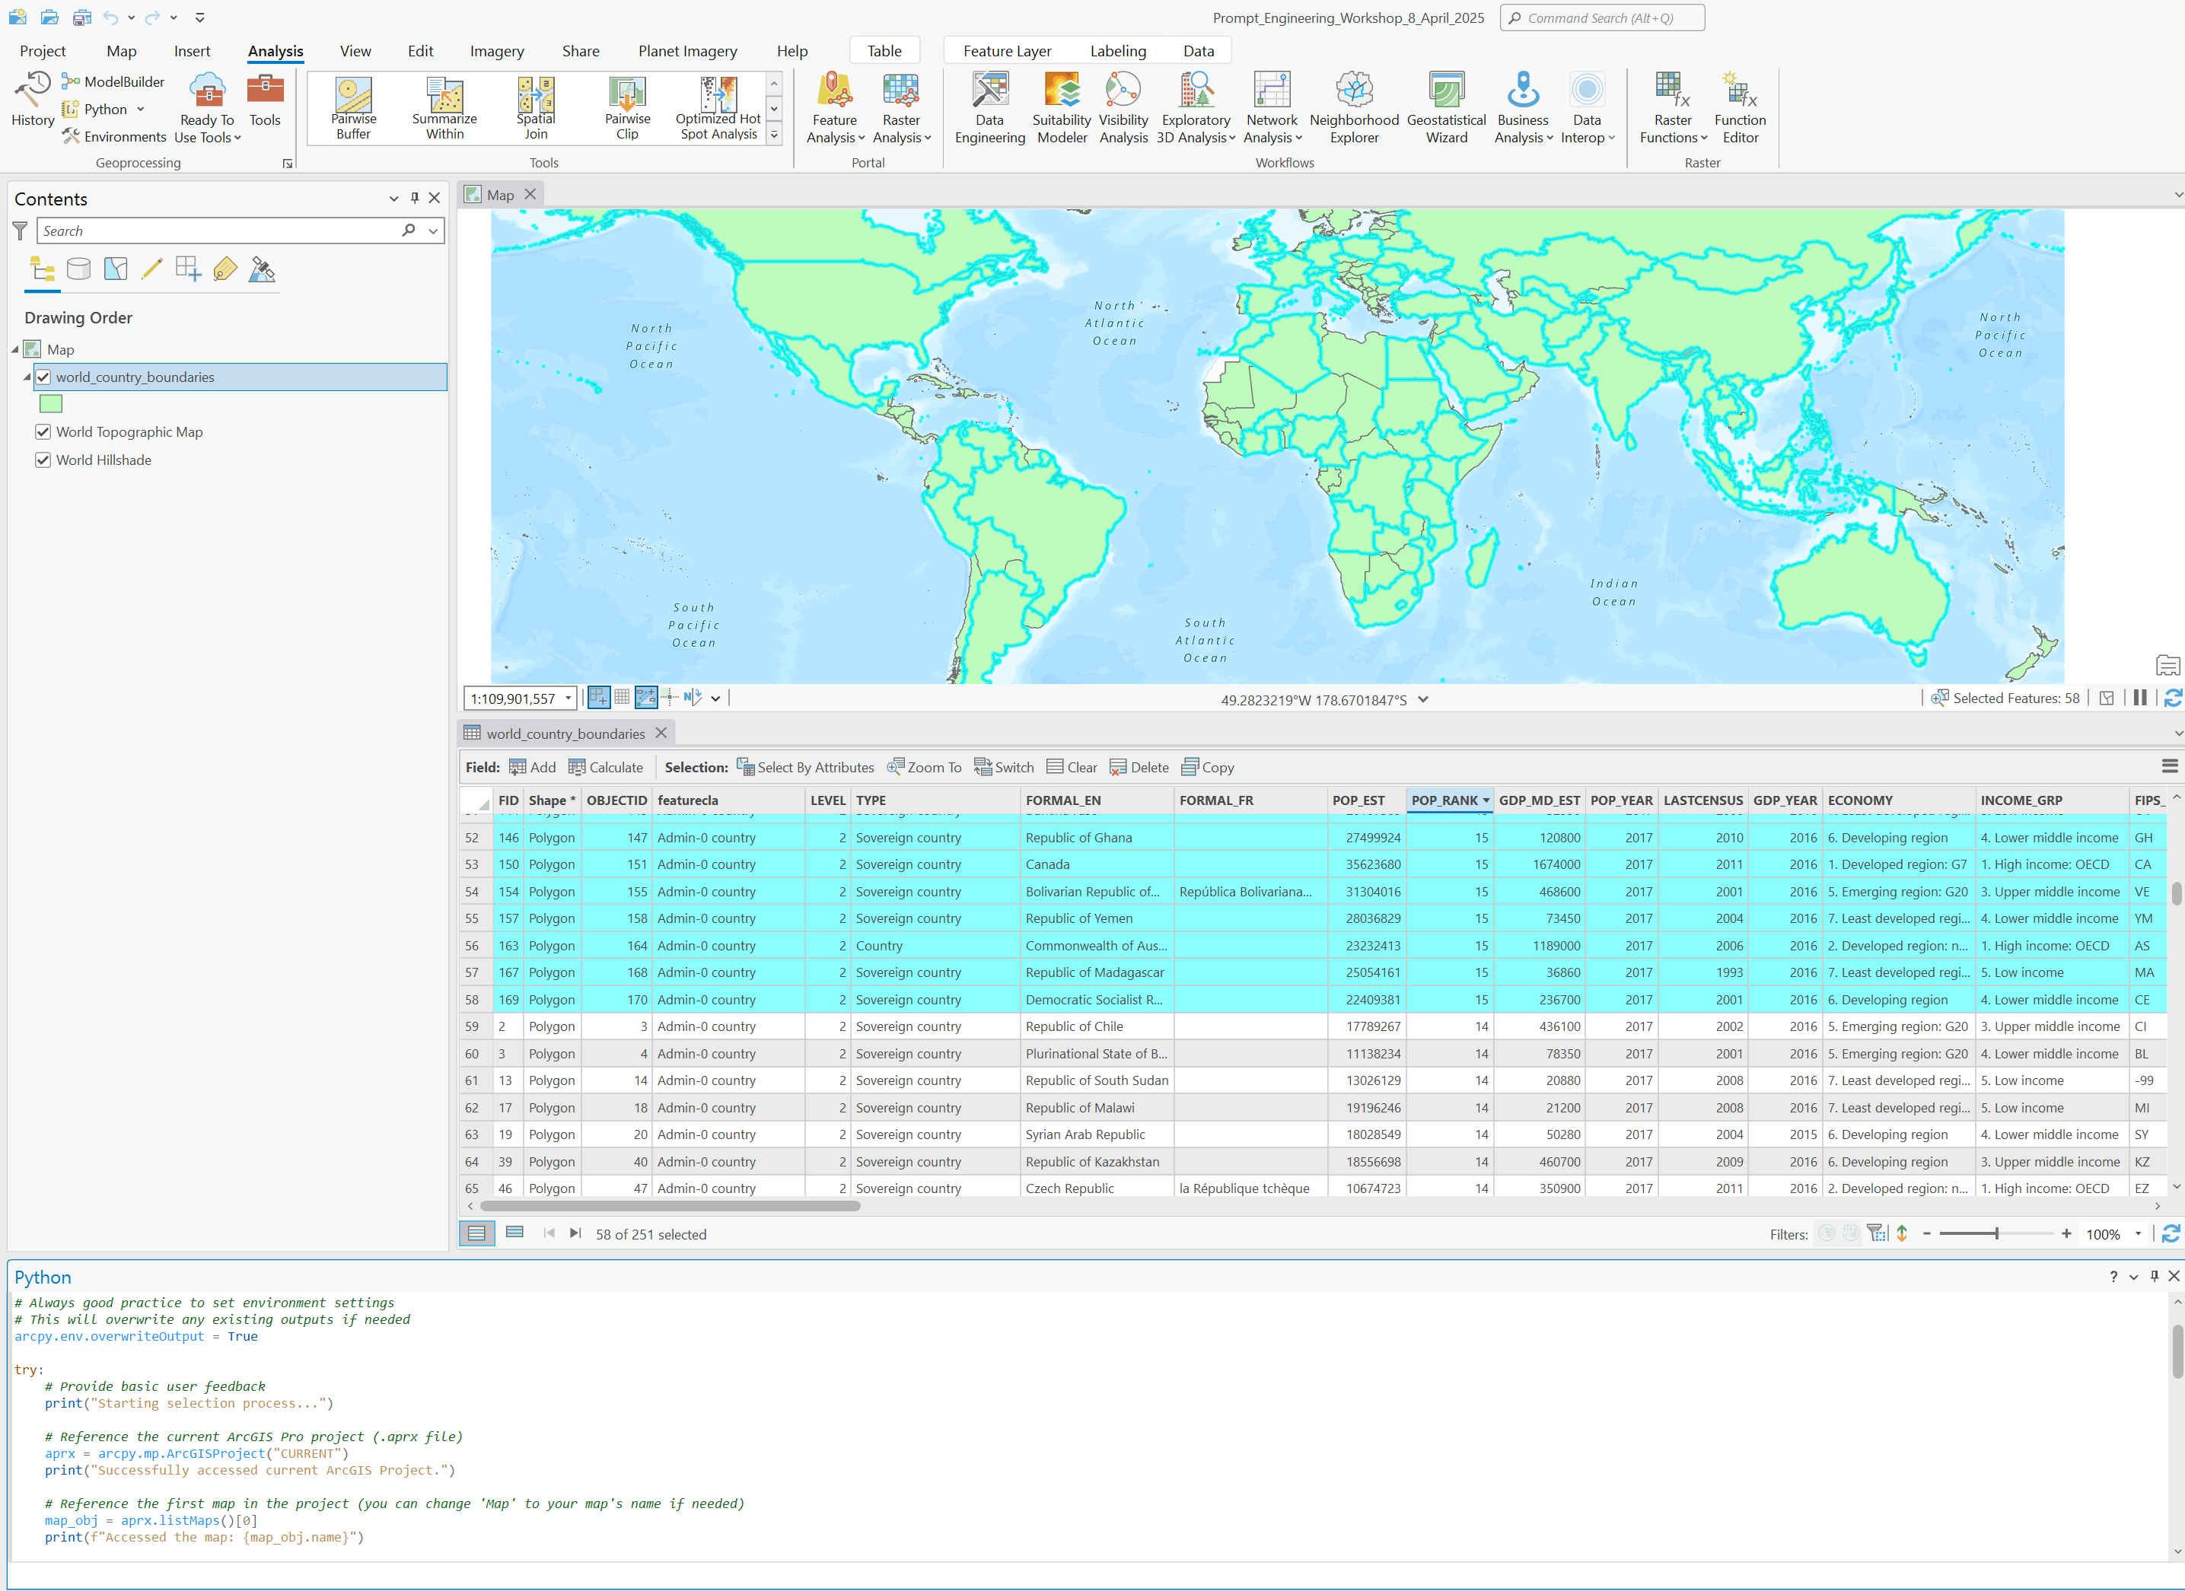

Slide 23
Example – ArcGIS Pro – Adding more..
You are skilled data analyst who's is an expert knowledge in geographic information systems. With that in mind, I would like for you to generate for me a python script that will work with ArcGIS Pro ArcPy to accomplish the following tasks.
Select features from a layer in the map called ‘world_country_boundaries’ where values in the field ‘POP_RANK’ are greater than or equal to 15.
After you have made the selection, the features that were selected from ‘world_country_boundaries’ should then be exported as a new shapefile called ‘populated_world_countries’. You must save this new shapefile in the C:\ temp directory.
Provide extensive comments in all the code that you create and provide error handling for any problems might occur. Also provide basic feedback such as simple print statements as the process is running so the user knows what is happening.
prompt_basic_query_export.txt

Slide 24
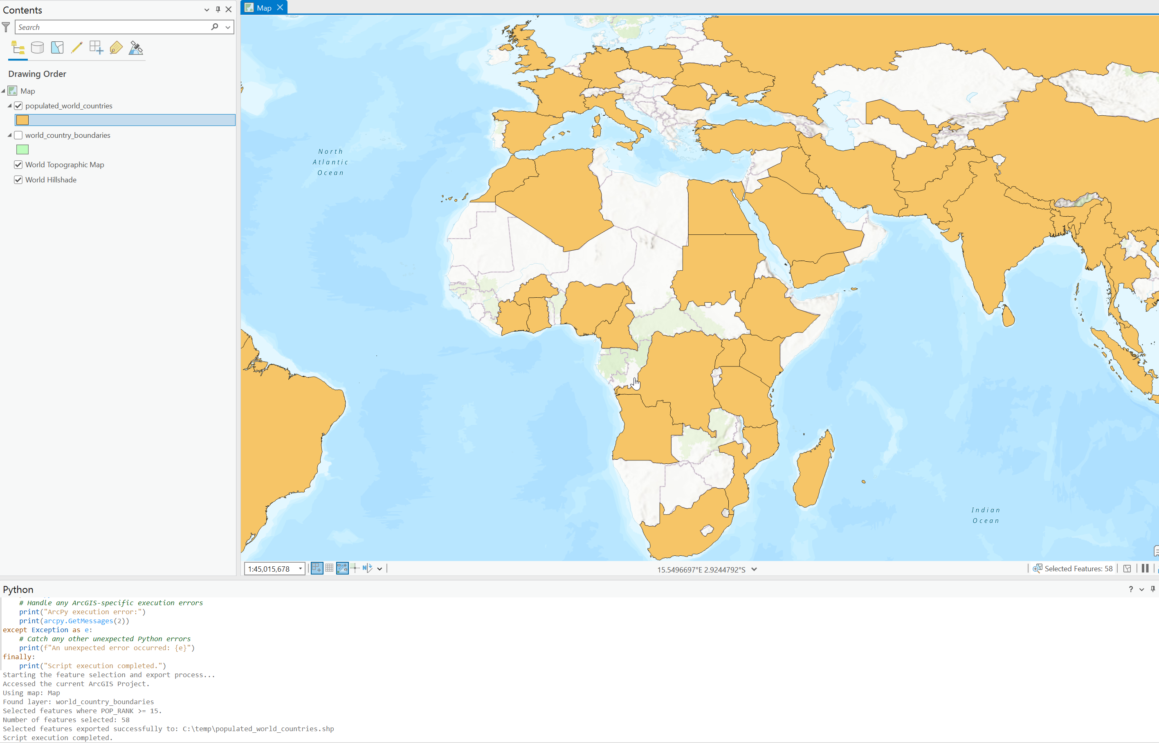
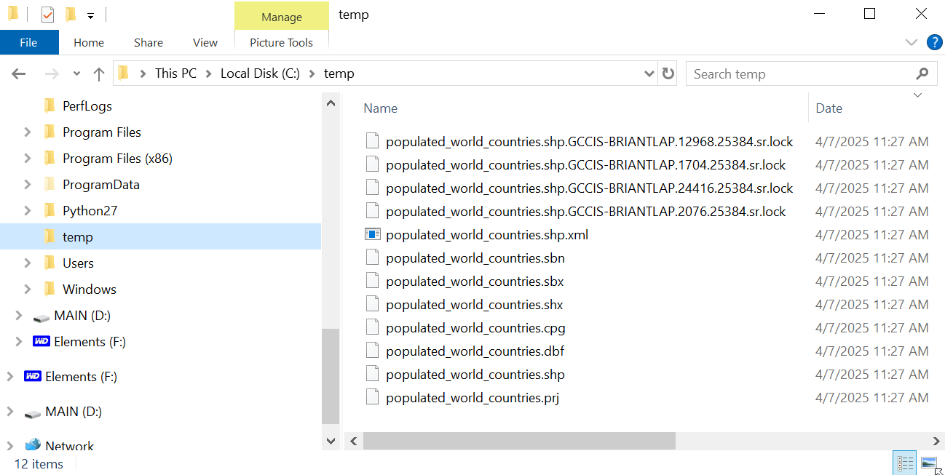

Slide 25
Troubleshoot Code
Follow-up prompts to fix coding
Sometimes it can fix itself
May not always work
Need to fix yourself – Python skills

Slide 26
ArcGIS Pro – Symbology – DID NOT WORK
You are skilled data analyst who's is an expert knowledge in geographic information systems. With that in mind, I would like for you to generate for me a python script that will work with ArcGIS Pro ArcPy to accomplish the following tasks.
Write me a script using Esri ArcPy that will run inside of ArcMap python window and will do the following:
Modify the symbology of the layer ‘world_country_boundaries’ using the following approach. Create a five class equal interval representation using the ‘POP_RANK’ field. Use a color scheme that is relevant for showing thematic data on a geographic map using quantities. The color scheme must be something that people who are color blind will be able to read. In the code you generate add comments above the code that describe your reasoning behind why you picked the colors you did select. Do not set the workspace or create a new layer object.
Provide extensive comments in all the code that you create and provide error handling for any problems might occur. Also provide basic feedback such as simple print statements as the process is running so the user knows what is happening.
prompt_symbology.txt

Slide 27
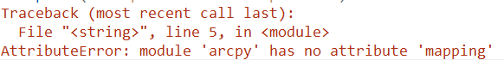
Troubleshooting Process/Prompts
In the code you sent I got there error:
Traceback (most recent call last):
File "<string>", line 5, in <module>
AttributeError: module 'arcpy' has no attribute 'mapping'
How to fix?
Please indicate what version of ArcPy you are using as a comment in the code

Slide 28
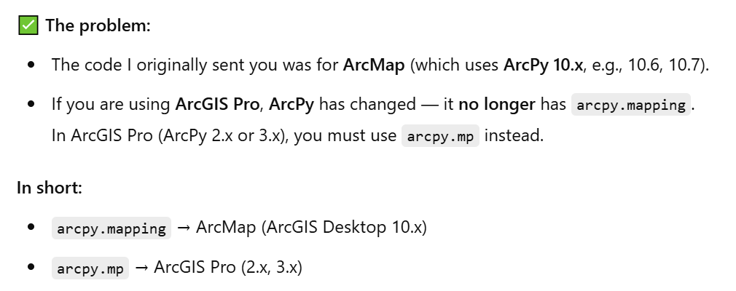


Fighting with AI…
I would like for you to generate for me a python script that will work with ArcGIS Pro ArcPy to accomplish the following tasks.
Say what??!!

Slide 29
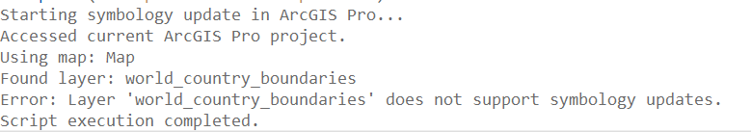
And it still didn’t work…

Slide 30
Troubleshoot Code
Follow-up prompts to fix coding
Sometimes it can fix itself
May not always work
Need to fix yourself – need Python knowledge

Slide 31
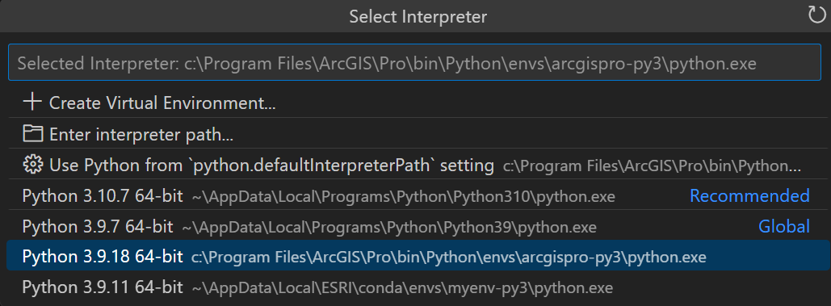
Setup Python via ArcGIS Pro in VS Code

Slide 32
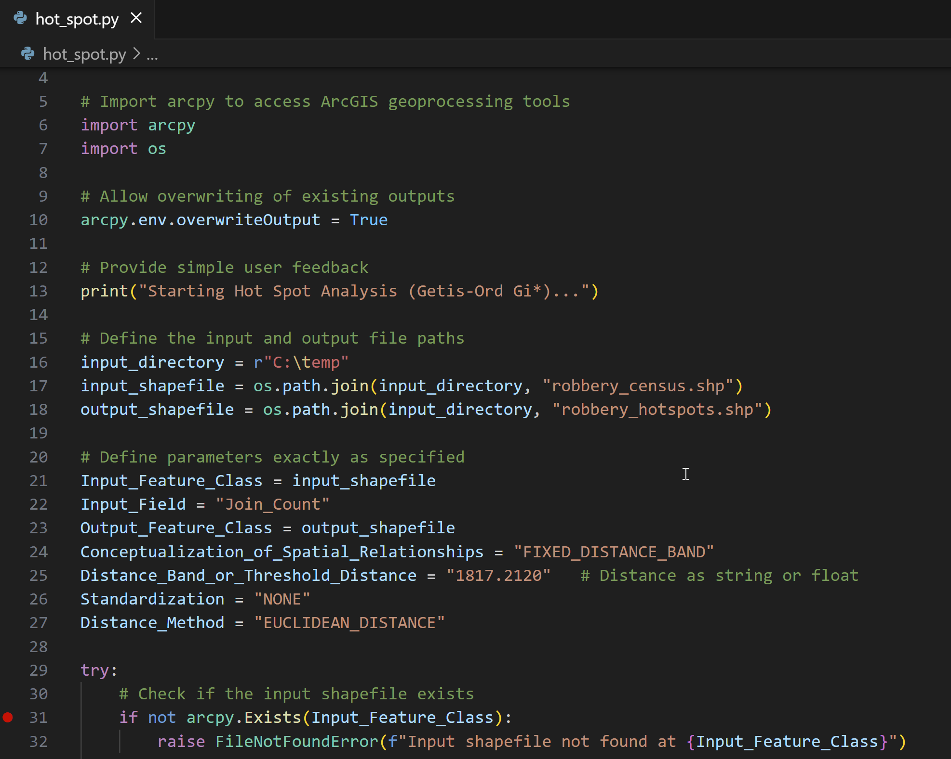
Hot Spots in VS Code
You are a skilled data analyst familiar with crime data and have expert knowledge in geographic information systems and spatial data science.
With that in mind, I would like you to generate a Python script that will work with ArcGIS Pro ArcPy to accomplish the following tasks:
Run the Hot Spot Analysis (Getis-Ord Gi*) on a shapefile called robbery_census.shp, located in the C:\temp directory.
Save the output shapefile to C:\temp, naming it robbery_hotspots.shp.
When running the Hot Spot Analysis tool, you must use these exact parameters:
Input_Feature_Class: robbery_census.shp
Input_Field: Join_Count
prompt_hotspots.txt

Slide 33
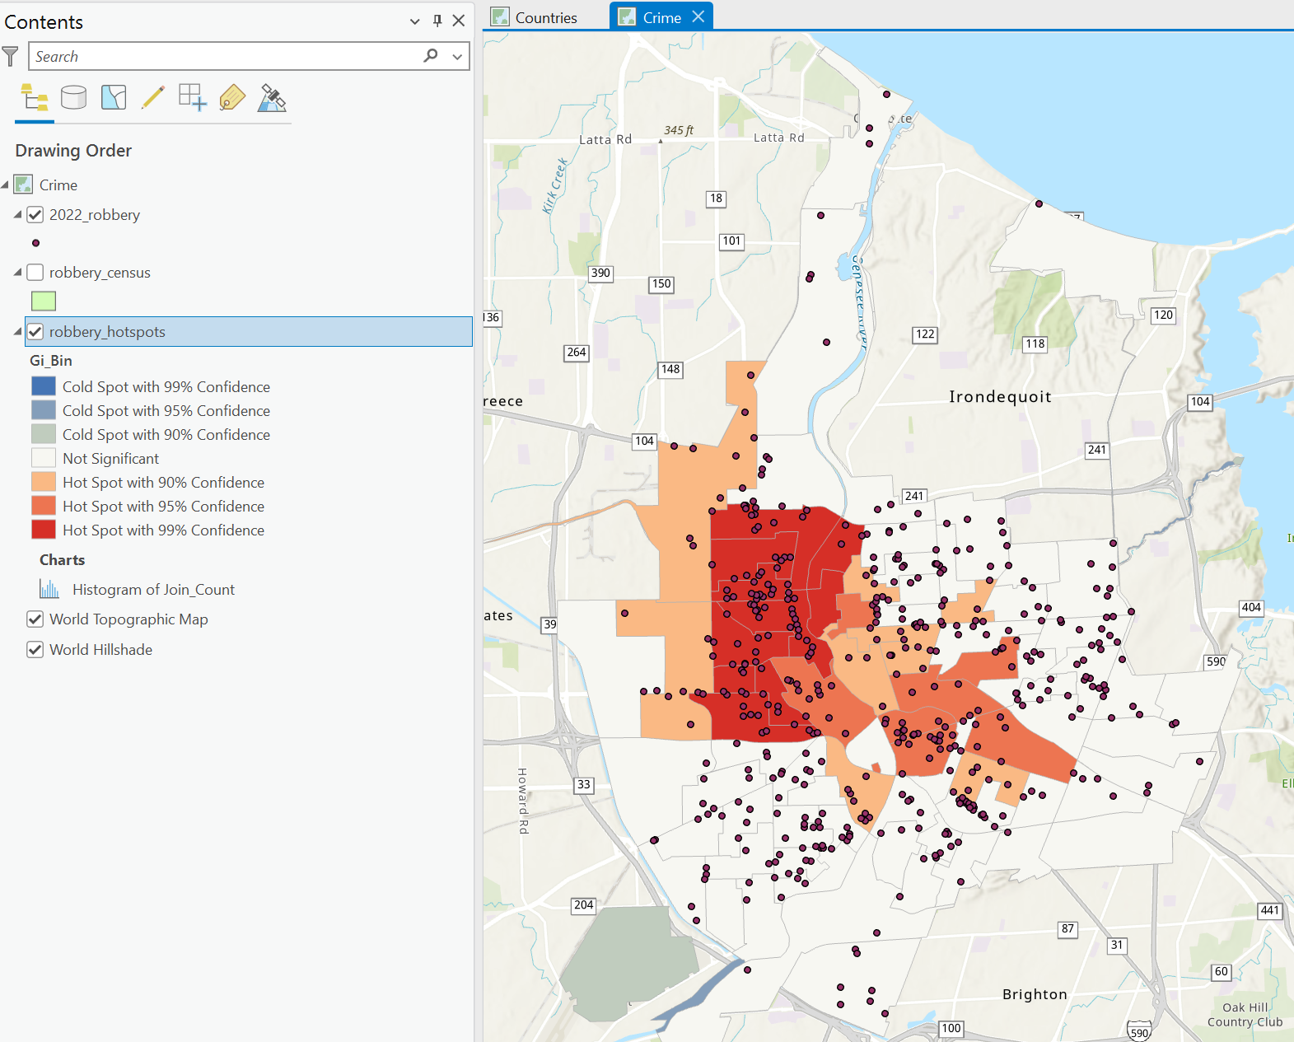

Slide 34
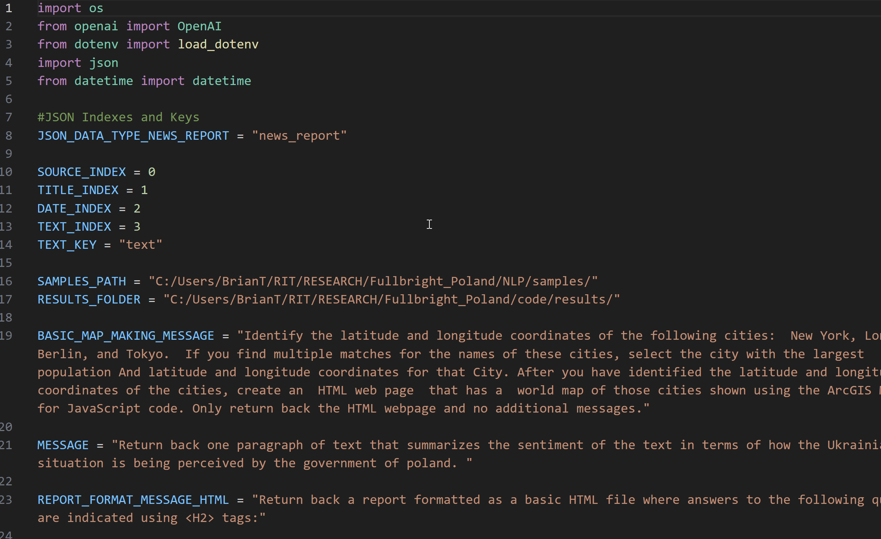
FYI – Open AI API

Slide 35
FYI – RIT Certified: Spatial Data Science
bmtski@rit.edu
https://certified.rit.edu/

